Slide 1
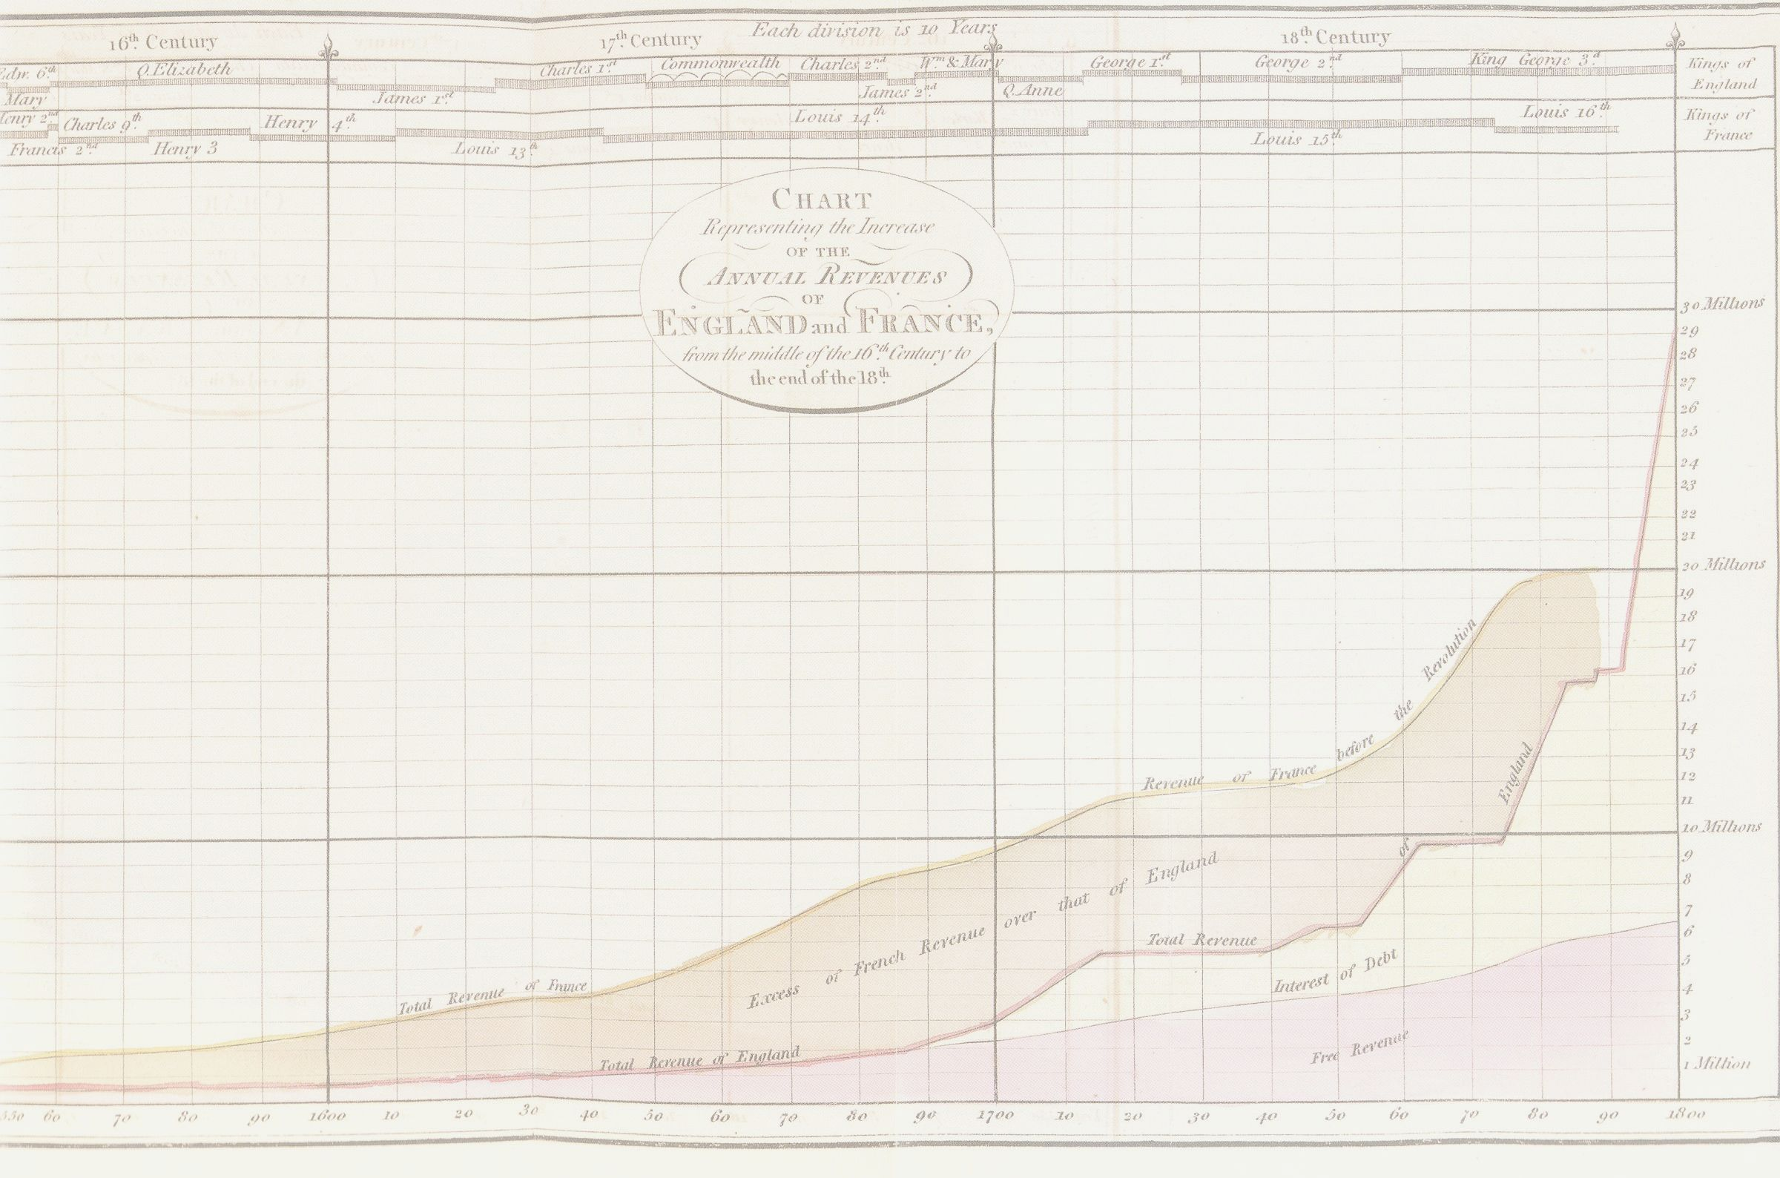
Designing High Quality Statistical Graphs
Ohio Program Evaluators’ Group
September 30, 2016
Cleveland, OH
Ray Lyons, Library Statistics Consultant Cleveland OH, USA
raylyons@gmail.com
http://libperformance.com

Slide 2
Note: This PowerPoint file includes an ADDENDUM with additional graphing guidelines—for line charts, bar charts, and use of color—not presented in the OPEG workshop due to time limitations.
Background image from The Commercial and Political Atlas, William Playfair, 3rd edition, 1801. The first edition was published in 1768. Playfair is the inventor of statistical graphs. His brother was the famed Scottish mathematician, John Playfair.

Slide 3
Session Objectives
To increase awareness of principles and practices for designing effective statistical graphs
To appreciate the need for graphical clarity and accuracy
To spark an interest in further study of best practices in graphical data design

Slide 4
Expert Sources
Cleveland, William S.
Visualizing Data, 1993, Summit, NJ: Hobart Press.
The Elements of Graphing Data, 1994, revised edition, Summit, NJ: Hobart Press.
Tufte, Edward R.
The Visual Display of Quantitative Information, 1983, Cheshire, CT: Graphics Press.
Visual Explanations: Images and Quantities, Evidence and Narrative, 1997, Cheshire, CT: Graphics Press.
*
Notes:
William Cleveland is an engineer who worked at AT & T Laboratories and published two very exacting books on statistical chart design. His is a good source for thinking of the technical reasons for some of the graphing guidelines.
Edward Tufte is known more for his critiques of graphs in newspapers and print media, in particular artistic exaggerations and distortions of data in graphs. He has been giving workshops nationwide for some years on his ideas about clarity and beauty in graphical data representation.

Slide 5
Expert Sources
Wainer, Howard
Visual Revelations: Graphical Tales of Fate and Deception from Napolean Bonaparte to Ross Perot, 1997, New York: Copernicus.
Graphic Discovery: A Trout in the Milk and Other Visual Adventures, 2005, Princeton, NJ: Princeton University Press.
Picturing the Uncertain World: How to Understand, Communicate, and Control Certainty, 2009, Princeton, NJ: Princeton University Press.
*
Notes:
Howard Wainer is a favorite statistical writer of mine. His books are somewhat similar to Tufte’s, but he also tends to write about more analytical problems—and about STATISTICAL THINKING REALLY. He shows how useful graphs help us tackle these problems and think statistically.

Slide 6
Expert Sources
Wong, Dona M.
The Wall Street Journal Guide to Information Graphics: The Do’s and Don’ts of Presenting Data, Facts, and Figures, 2010, New York: W.W. Norton and Co.
Few, Stephen
Now You See It: Simple Visualization Techniques for Quantitative Analysis, 2009, Oakland, CA: Analytics Press.
*
Notes:
Dona Wong’s book is a style guide for creating clear and consistent statistical graphs. Hers is a good book to begin with for the do’s and don’ts for clarity, issues of formatting, use of color, font choices, and so on.
Stephen Few became an expert in dashboard design in the early 2000’s and is pretty much the major critic of statistical software companies and their repeated and unending use of poor design principles in their products. His book covers this whole arena very thoroughly—definitely worth looking at.

Slide 7
Why Graphical Data Presentation / Data Visualization?
Visual perception is more immediate than sequential scan of numbers and letters
Leads from the specific and literal to the general and abstract (which is what we are most often interested in)
*
Notes:
To begin I’ll be explaining the general theory or reasoning behind principles of good graphing practices. This theory is built on some basic reasons for using graphs at all.

Slide 8
Why Graphical Data Presentation / Data Visualization?
Portraying quantitative data graphically can reveal features of the data that may otherwise remain hidden
Visual depictions of data are nearly universally understood without requiring knowledge of language

Slide 9
Edward Tufte
On Graphical Excellence
“Gives the viewer the greatest number of ideas in the shortest time with the least ink in the smallest space.
Shows data variation, not design variation.
Requires telling the truth about the data.”
Edward R. Tufte, The Visual Display of Quantitative Information
Notes:
READ

Slide 10
William Cleveland Principles of Data Graphics
“Make the data stand out. Avoid superfluity.
Use visually prominent graphical elements to show the data.”
William S. Cleveland, 1994, The Elements of Graphing Data
Notes:
READ

Slide 11
Two Approaches to Visual Presentation of Data
Data Graphics | Graphical presentation of quantitative data to explore, analyze, understand, and/or reveal patterns and trends in the data
Data Art / Infographics | Graphical presentation of quantitative data to persuade and/or entertain
*
Notes:
Nowadays there are two general approaches or “schools” of data presentation aka data visualization. The 1st is called DATA GRAPHICS. IT IS….
The 2nd approach is what Stephen Few labels as DATA ART, and is also known in several fields and industries as Infographics. INFOGRAPHIS ARE:

Slide 12
Data Graphics emphasize: | Data Art/Infographics emphasize:
Discovery, data exploration | Persuasion, selling
Clarity, simplicity | Entertainment, appeal to emotions
Thoroughness, truth-telling | Bias, data selectivity, information reduction
Balance, objectivity | Overstating favorable evidence; downplaying contrary evidence
Notes:
READ

Slide 13
Data Art
The claim that “students feel safer at recess” stretches the truth. The study measured teachers’ perceptions of students’ feelings about safety and inclusion.
Image from 2012 Robert Wood Johnson Foundation grantee: www.playworks.org
*
Notes:
Because infographics are created by graphic designers and marketing professionals, inaccuracies and exaggerations abound. Attention to quantitative principles and even basic arithmetic is low or non-existent.
In this graphic, from a project funded by the Robert Wood Johnson Foundation, we see 4 claims summarized from an evaluation study. 3 of the claims have pie charts next to them, and the other an hour glass. The pie charts and hour glass are about equally informative. The only useful quantitative content are the numbers, everything else is decoration.
As noted in my comment here…READ

Slide 14
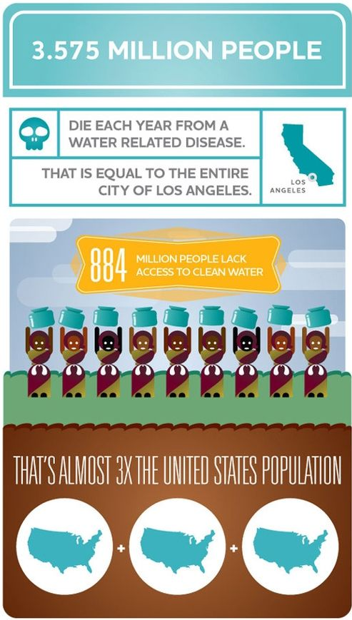
Dumbing down data can be fun and lucrative.
Eminent graphic designer/data-journalist David McCandless’s graphics “communicate complicated information in pleasing and efficient ways.”
But his renderings suggest he is innumerate.
Image and quotation source: http://culturalorganizing.org/tag/david-mccandless/
*
Notes:
READ
McCandless doesn’t worry (or maybe doesn’t know) about wonky details like data units. Here population counts are equated with geographic square miles. (Does a picture of California with Los Angeles marked enhance the reader’s understanding of the data? And do you need 3 maps of the U.S. to understand what a factor of 3 to 1 is? THIS IS ALL PURE ENTERTAINMENT.
Since the women symbolize people lacking access to clean water, does this mean the jugs contain dirty water or are empty?

Slide 15
How to Identify a
Real Data Graphic in the Wild
Contains one or more axes (scales). At least one axis is a number line.
Locations of data points along the axes match their quantities or qualities.
Spatial arrangements directly reflect quantitative/qualitative aspects of the data.
Notes:
READ

Slide 16
How to Identify a
Real Data Graphic in the Wild
If a graphic contains images of these or similar objects, it is not a Data Graphic:
martini glasses | fire works | Monopoly characters
oil derricks | airplanes | cell phone towers
stick figures | nuclear missiles | American flags
French fries | battle ships | scissors
birds | coffee mugs | space shuttles
kitchen utensils | automobiles | craft beer bottles
ants | dancers | baseball diamonds
skyscrapers | lawn mowers | Dead Sea Scrolls
 | etc., etc., etc.
Notes:
READ

Slide 17
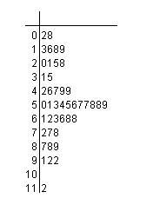
Good Graphical Formats Clarify Data
by Making Patterns and Trends Visible
John Tukey’s Stem-and-Leaf Plot
Data: 72, 18, 112, 87, 92, 54, 16, 8, 13, 66, 77, 92, 55, 42, 25, 28, 31, 68, 21, 19, 2, 46, 49, 58, 20, 78, 88, 89, 91, 59, 56, 53, 49, 58, 47, 57, 51, 61, 62, 68, 63, 57, 50, 35
*
Notes:
Probably the quintessential—and simplest—graphical format that demonstrates the power of graphing is John Tukey’s Stem-and-Leaf Plot. By simply sorting the data using the 10’s column (and recording each value’s far right digit as a tick-mark really), we see instantly something about the data. How it is distributed. How many high values there are, how many low. And so on…

Slide 18
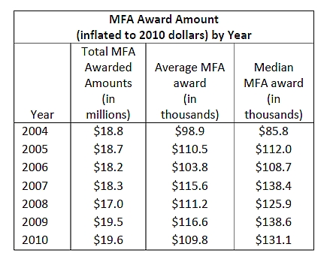
The line chart immediately suggests a question that a reader casually scanning the table may miss: ‘In 2005, why did median award levels begin to outpace average levels?’
Table from Apley et al., Supporting Museums-Serving Communities: An Evaluation of the Museums for America Program, 2011, U.S. Institute for Museum and Library Services.
*
Notes:
The same in this chart on the right of data from the table on the left: Immediately, spatial arrangement of the data paves the way for learning more about the data, and the topic of interest here—grant funding over time. READ

Slide 19
Make Charts Neat, Clear, Simple
“Strive for clarity. Draw attention to the important features of the data.”
- William Cleveland
Each graphical element should aid in communication of information.
Avoid distractions that hinder readability and interpretation (‘decoding’) of data.
Notes:
READ

Slide 20
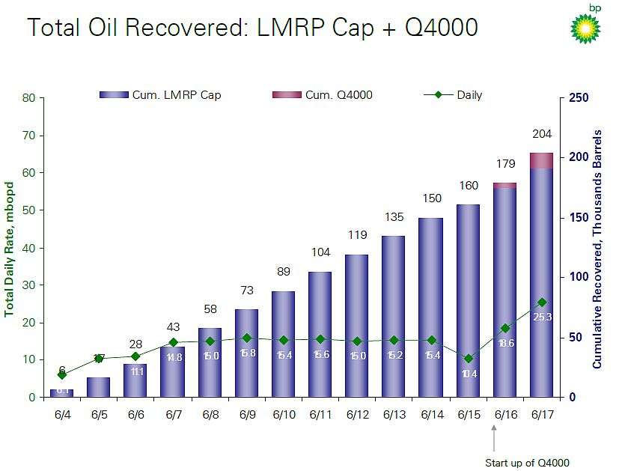
Components of a Chart
CHART
TITLE
AXIS LABEL
(OR AXIS TITLE OR SCALE LABEL)
VERTICAL AXIS (SCALE)
HORIZONTAL AXIS (SCALE)
Adapted from William Cleveland, 1994.
*
Notes:
Before delving into the selection of graphing guidelines I have for you today, it is helpful to take the time to agree on a vocabulary for the parts/components of statistical charts.
CHART TITLE
AXES -- Always at least 2 axes. By axes we mean a set of sub-components attached to the axis, such as the line, numeric labels and others I’ll list next.
AXES HAVE TITLES.

Slide 21
Components of a Chart
KEY (LEGEND) SYMBOL
KEY (LEGEND)
TICK MARK
DATA LABEL
AXIS VALUE LABELS (TICK MARK LABELS)
AXIS (SCALE) LINES
Adapted from William Cleveland, 1994.
*
Notes:
AXIS VALUE -- Axes are always labeled with scale values—units of measure, dates, etc.
Axes have TICK MARKS showing measured segments of the scale. And of course, like rulers, there can be TICK MARKS between scale values.
LEGENDS – some charts have legends, as this one does. A LEGEND (OR KEY) has 2 components: a KEY SYMBOL and a DATA LABEL. Each DATA LABEL represents a single variable (measure) and the SYMBOL translates that variable name to a MARKER OR SHAPE on the graph. In this case to segments of the bars and, for the right legend item, a DIAMOND MARKER on the green plotted line.

Slide 22
Components of a Chart
DATA LABEL
DATA VALUE
LINE MARKER (PLOTTING SYMBOL)
NOTE (ANNOTATION)
Adapted from William Cleveland, 1994.
*
Notes:
In contrast with the term “DATA LABEL” there is also the term “DATA VALUE”, which refers to numbers appearing near the plotted chart markers/points to indicate the actual value that marker/point represents. To aid readers in evaluating the magnitude the marker/point represents.
Finally, a marker can also be associated with lines as seen in the green line here. These help readers visually interpret line locations—since these markers are always positioned exactly over horizontal axis data labels.

Slide 23
49
Components of a Chart
KEY (LEGEND) SYMBOL
CHART
TITLE
KEY (LEGEND)
TICK MARK
DATA LABEL
AXIS LABEL
(OR AXIS TITLE OR SCALE LABEL)
DATA VALUE
VERTICAL AXIS (SCALE)
LINE MARKER (PLOTTING SYMBOL)
AXIS VALUE LABELS (TICK MARK LABELS)
AXIS (SCALE) LINES
HORIZONTAL AXIS (SCALE)
NOTE (ANNOTATION)
Adapted from William Cleveland, 1994.
*
Notes:
So there you have it – a vocabulary for talking about charts. Except there’s one more to name… NEXT SLIDE

Slide 24
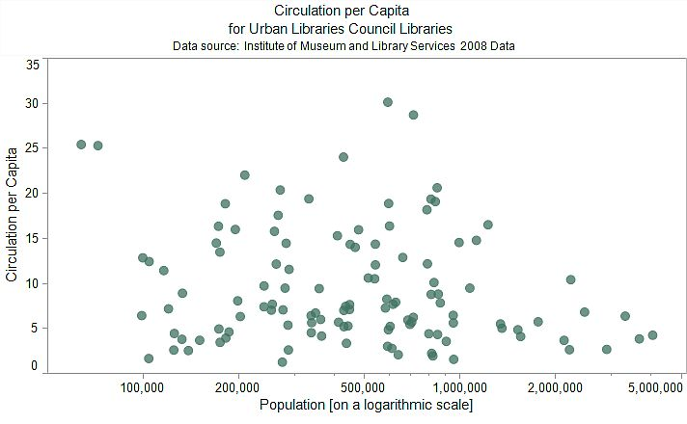
Components of a Chart
DATA AREA
(DATA RECTANGLE)
The data area or data rectangle is the area inside the boundary of the axes where the data are plotted.*
*MS Excel calls this the plot area and the area outlined by the axes the
chart area.
Notes:
READ

Slide 25
Components of a Chart
DATA
VALUE
DATA LABEL
DATA LABEL
A data label names the variable or series plotted. A data value is a number indicating a specific value for a given variable.
Notes:
READ

Slide 26
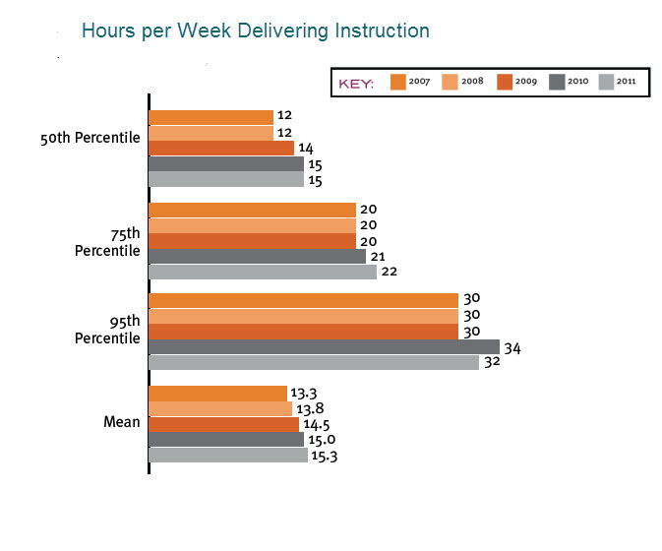
Re-Design of a Data Graphic
(to make exploring the data easier)
Image source: American Association of School Libraries, School Libraries Count! Survey, 2011
*
Notes:
Before I get to specific graphing guidelines—the meat of this presentation--I want to take you through an quick exercise in making a chart more useful for exploring data. This particular example begins with a chart that is relatively common—a chart representing movement through time (years) as categorical variables in a bar chart. Not always the easiest way to compare multiple variables across time. So let’s see what can be done to make it more analytical-friendly.

Slide 27
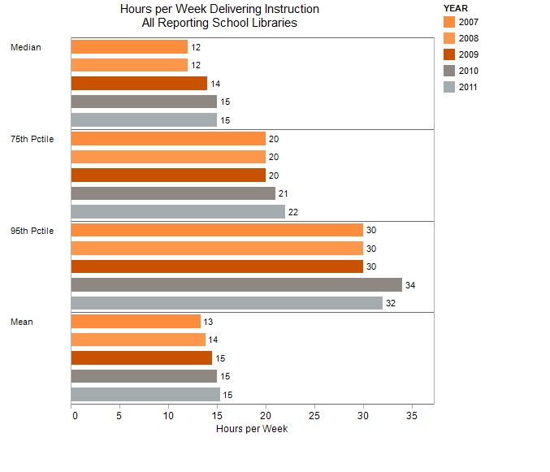
Re-Design of a Data Graphic
Step 1. Re-render in Tableau Software. Rename 50th percentile Median.
Notes:
READ

Slide 28
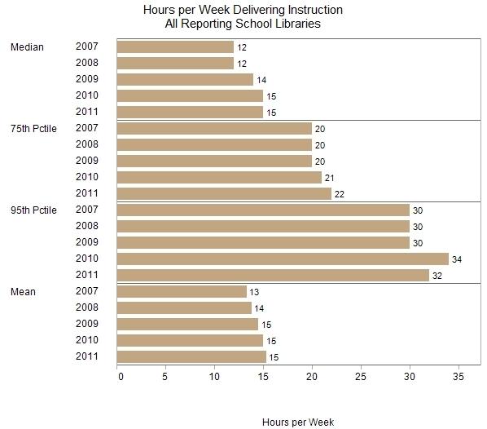
Re-Design of a Data Graphic
Step 2. Move Year from legend to vertical axis. Remove legend and color-coding.
Notes:
READ

Slide 29
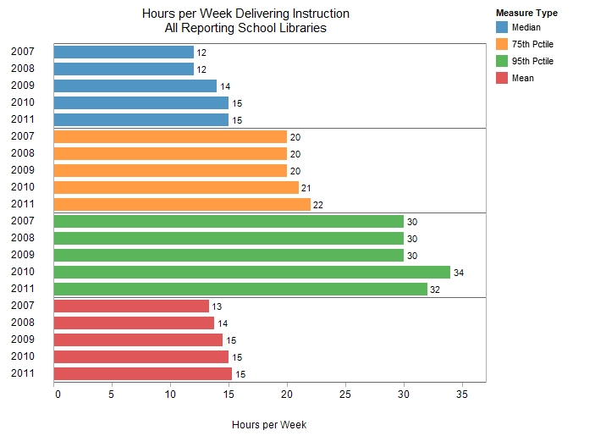
Re-Design of a Data Graphic
Step 3. Move Measure Type to legend, color-coded.
Notes:
READ

Slide 30
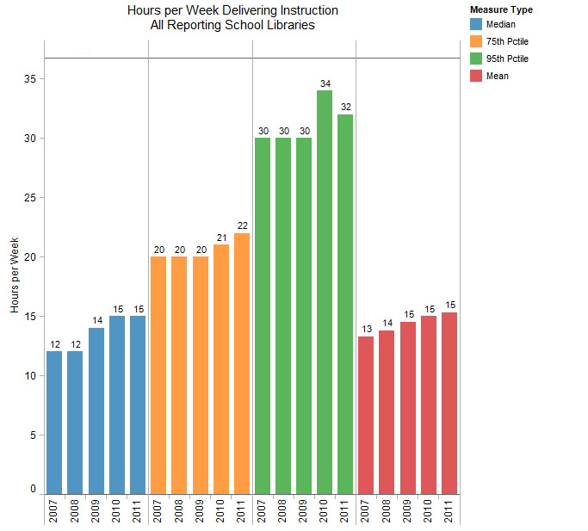
Re-Design of a Data Graphic
Step 4. Rotate chart so Year appears on horizontal axis.
Notes:
READ

Slide 31
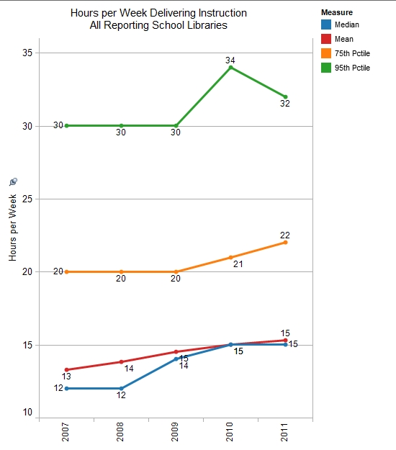
Re-Design of a Data Graphic
Step 5. Remove repetitions of Year from horizontal axis. Replace bars with horizontally stacked lines.
Notes:
READ

Slide 32
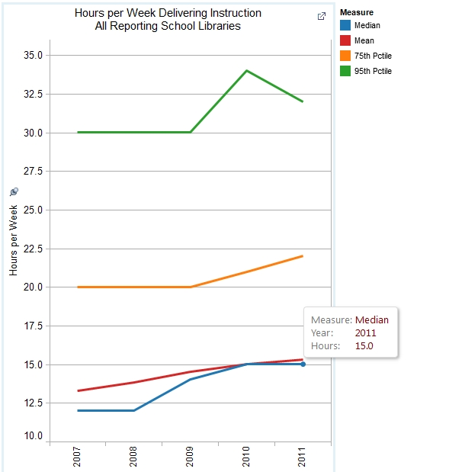
Re-Design of a Data Graphic
Step 6. Remove data value labels since these can be displayed via interactive software.
(Keep horizontal gridlines intact to aid visual evaluation.)
Notes:
READ

Slide 33
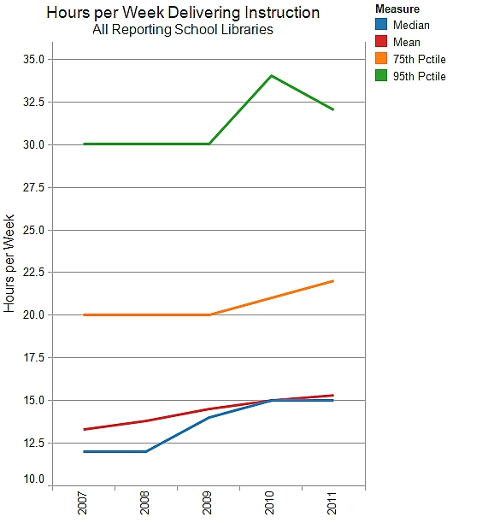
BEFORE
AFTER
*
Notes:
Here is the final comparison. Undoubtedly, executive directors and boards will find the bar chart more interesting in a slick annual report (it’s colorful and implies content and data and things being analyzed!!) But for understanding the data quickly, the humble and sparse line chart is superior.

Slide 34
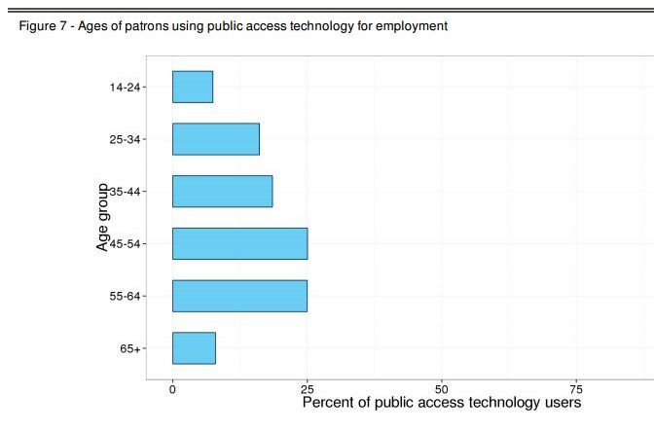
Begin with Basic Neatness
Don’t rely on statistical software packages to render clear and neat results.
*
Notes:
So now we can get to basic good graphical practice guidelines. The best place to start is with neatness (meaning clarity and ease of readability for users).
These are published charts whose creators did not monitor and override their software packages in order to guarantee that readers would have clear labeling to work with.
DO NOT rely on statistical software packages to render clear and neat results. Very often programmers are unaware of good graphical design.

Slide 35
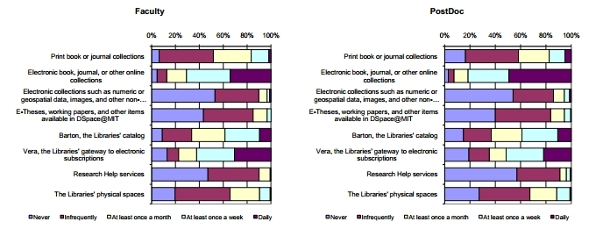
Clarity, Clarity, Clarity
Make axis labels, legends, and all chart components readable.
Image excerpted from MIT Libraries, Library Services Survey 2008.
Notes:
READ

Slide 36
Stacked Bar Segments Are Difficult to Evaluate
How do the yellow and green segments compare?
How much bigger is the violet segment than the white?
*
Notes:
Incidentally, the stacked bars in the prior slide are inherently difficult to DECODE i.e., visually estimate magnitudes.
ASK QUESTIONS

Slide 37
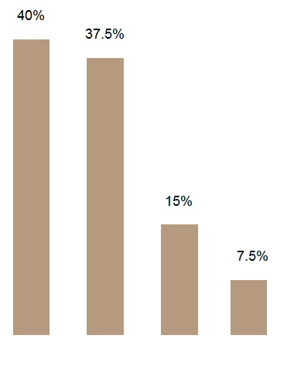
Avoid stacked (segmented) bars when possible.
For charts with one variable, use same-color bars aligned on the horizontal axis to allow easy visual comparisons.
When plotting part-to-whole comparisons of variables, supplement these with separate charts for each variable.
Notes:
READ

Slide 38
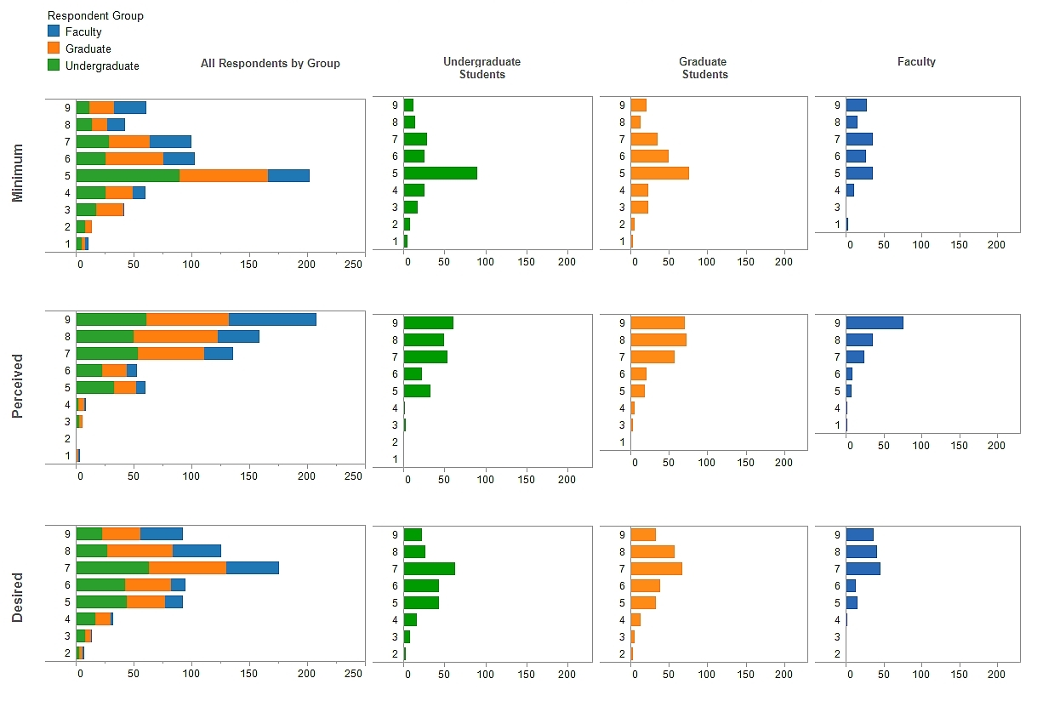
*
Notes:
On the left you can see that charts showing aggregate values by variable (and variable values) can be useful if readers are interested in all respondents as whole. Including the charts in the right 3 columns makes the reader’s work easier by providing a consistent baseline for each set of bars, something missing in the segmented bars in the left column.
AGAIN, THE USER CAN INTERPRET THE DATA FOR THEMSELVES WHEN THEY ARE CLEARLY REPRESENTED.

Slide 39
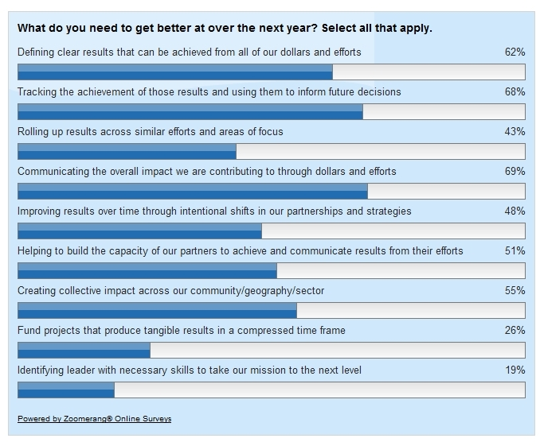
Don’t emulate designs from online survey software packages.
Labels in this Zoomerang-produced chart interfere with perception of horizontal bar lengths.
Image source: What Works website, Renssellaerville Institute. http://www.whatworks.com
*
Notes:
This chart is from the What Works website from a few years back. It has several bad features, one I list here and others I’ll address in the next slide.
But first, BEWARE OF software companies and their programmers. They are almost always graphically and numerically illiterate.
A main problem with the slide is that the long axis labels (almost sentences) obscure the lengths of the blue bars—or at least make the reader’s eyes struggle separating the two.

Slide 40
Re-designed What Works Survey Chart*
Place axis labels adjacent to axis (not in data area).
Make axis labels succinct.
Locate data values near plotted data.
Sort bar chart data to increase informativeness.
* See prior slide
Notes:
READ

Slide 41
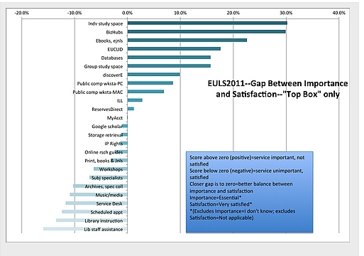
Include narrative in data rectangle as needed, without masking data. Be sure text is readable.
Avoid using color-fading in charts. (It implies that some data are more or less important than others.)
Image source: Emory University library website.
*
Notes:
This chart violates the guideline to separate axis labels from the data area. But it does illustrate a perfectly legitimate technique—inserting annotations or narratives inside the data rectangle.
ALSO, don’t use color-fading to represent magnitude/quantity. Leave that work to the axes and bars.

Slide 42
Accuracy, Accuracy, Accuracy
“The representation of numbers, as physically measured on the surface of the graphic itself, should be directly proportional to the numerical quantities represented.”
- Edward Tufte
Notes:
READ

Slide 43
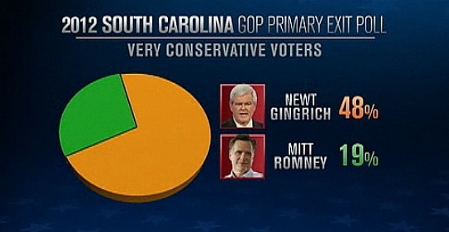
Maybe this chart’s inaccuracy is due to a typographical error?
Proofread charts carefully.
Image source: MSNBC Meet the Press, Jan 22, 2012.
Notes:
READ

Slide 44
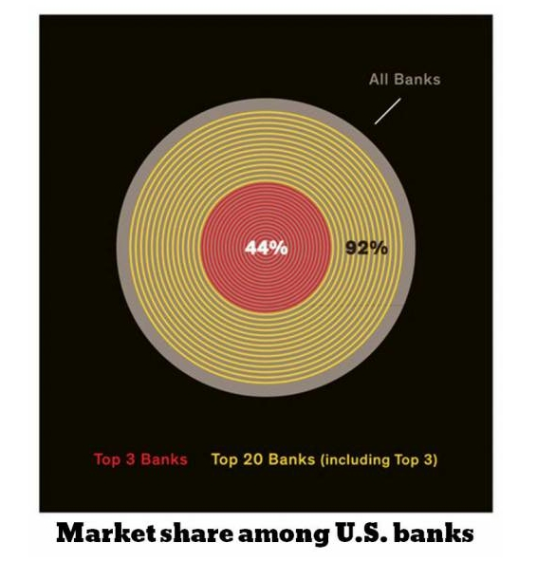
A violation of Tufte’s requirement that charted image surface size accurately matches data quantities.
Image source: New York Times Magazine, duplicated in John Gargani’s blog, EVALBLOG, http://evalblog.com
Notes:
READ

Slide 45
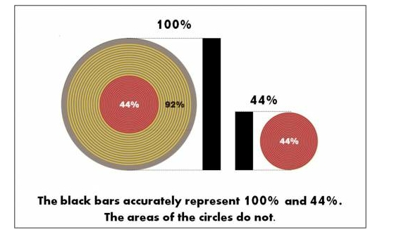
Image source: John Gargani’s EVALBLOG. Used with permission.
Notes:
READ

Slide 46
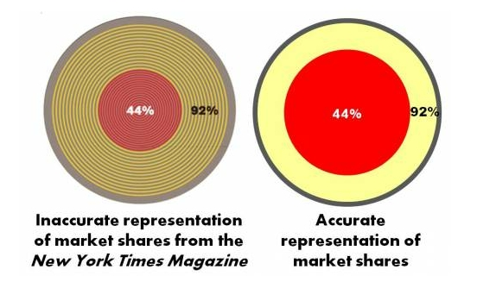
Avoid using circle charts.
Circle charts are deceiving and difficult to draw correctly.
A circle’s height is proportional to the square root of its area. (Remember πr².)
Image source: John Gargani’s EVALBLOG. Used with permission.
Notes:
READ

Slide 47
Accuracy, Accuracy, Accuracy
“The number of information-carrying dimensions depicted should not exceed the number of dimensions in the data.”
- Edward Tufte
Notes:
READ

Slide 48
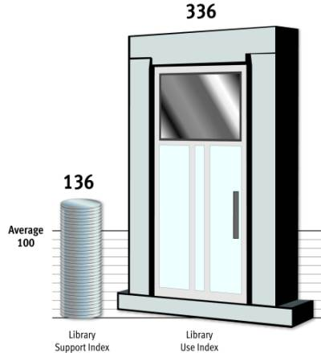
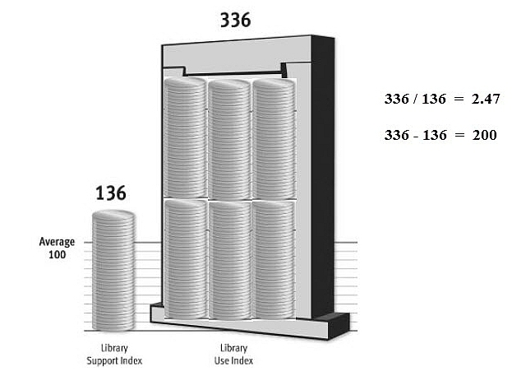
Original chart designed by Leo Burnett ad agency
My re-rendering to illustrate proportions
The data represented are one-dimensional quantities. Two-dimensional representation exaggerates the comparison.
Left image source: Online Computer Library Center, From Awareness to Funding, 2008. Chart design by Leo Burnett, Inc.
*
Notes:
You can see that probably the door is equal to about 8 stacks of coins – quite a distortion of the data. Then again flashy exaggeration is the goal of marketing firms and public relations professionals.

Slide 49
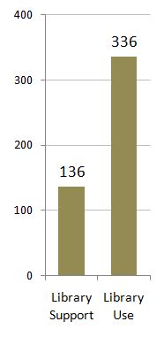
The bar chart on the right depicts the data accurately.
Left image source: Online Computer Library Center, From Awareness to Funding, 2008. Chart design by Leo Burnett, Inc.

Slide 50
Axes (Scales)
At a minimum, use and label two axes. Use four axes for clarity when desired.
Use visible, non-intrusive gridlines.
Make the data area slightly smaller than the chart boundaries.
Notes:
READ

Slide 51
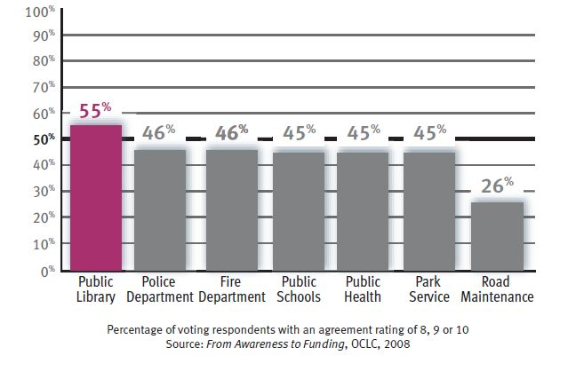
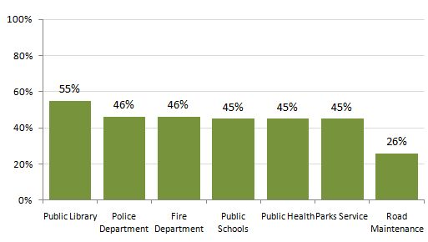
Too thick or too many gridlines compete with data points.
Use fewer and lighter gridlines, or no gridlines.
When data values are included, use fewer axis values and tick marks.
Notes:
READ

Slide 52
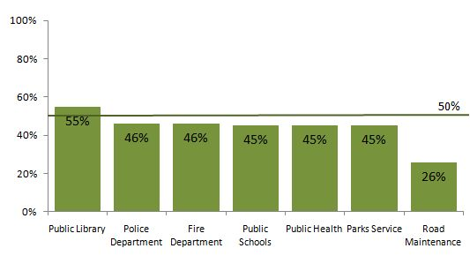
Reference line
When using a reference line* use light or no gridlines.
* A reference line is used to highlight a particular value or region of the chart that is notable, such as a benchmark value.
Notes:
READ

Slide 53
Axes (Scales)
Outward tick marks
Outward tick marks
Point tick marks outward, away from chart boundaries.
Notes:
READ

Slide 54
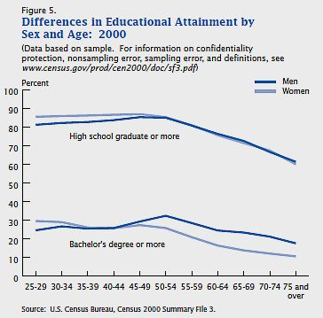
Inward pointing tick marks can be mistaken for data points. This is another reason for keeping the data area (data rectangle) intact.
Notes:
READ

Slide 55
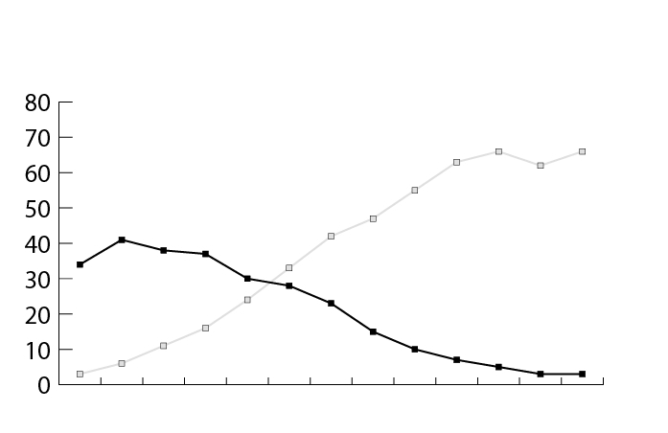
By default Adobe Illustrator line charts point tick marks inwards. MS Excel’s default is outward-pointing. Excel lets you change tick mark style, but don’t do it!

Slide 56
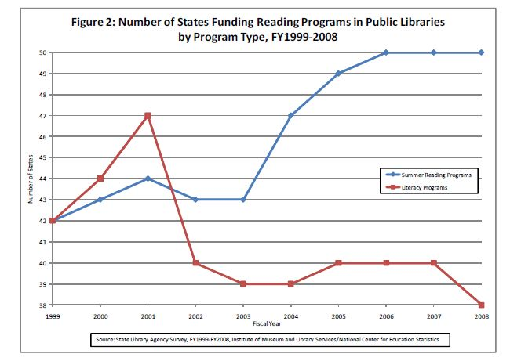
Axis value ranges should exceed upper data ranges.
Do not plot data on the chart axis lines, except for zero values.
Image source: U.S. Institute of Museum and Library Services, State Library Agency Survey Fiscal Year 2008
Notes:
READ

Slide 57
Axes (Scales)
User familiar numbering increments:
0, 1, 2, 3, 4, 5 . . .
0, 2, 4, 6, 8, 10 . . .
0, 5, 10, 15 . . .
0, 10, 20, 30 . . .
0, 25, 50, 75 . . .
0, 0.2, 0.4, 0.6 . . .
0, 0.25, 0.50, 0.75 . . .
Notes:
READ

Slide 58
Axes (Scales)
Use highest feasible units:
Use: Instead of:
$3 million 3,000 thousand
or 3M
2.6 billion 2,582,000,000
or 2.6B
1K, 2K, 3K 1000, 2000, 3000
Try to avoid requiring readers to do the math.
Notes:
READ

Slide 59
Determining Scaling
Scale span must encompass and exceed all of the data, except outliers intentionally excluded.
Begin the scale at zero or multiple of 2, 5, or 10.
For line charts and scatter plots, if data values are close to zero, include zero on axes.
For bar charts include zero or clearly indicate its absence to avoid misinterpretation of relative bar lengths.
Notes:
READ

Slide 60
Legends (Keys)
Place legend at or near top of chart, not in data area.
For line charts, use data labels instead of legends when possible.
Order data labels in legend to match the order of the data.
Notes:
READ

Slide 61
When possible, in line charts use data labels rather than legends (keys) to identify data variables plotted. When plotted lines cross or are too close, use a legend instead.

Slide 62
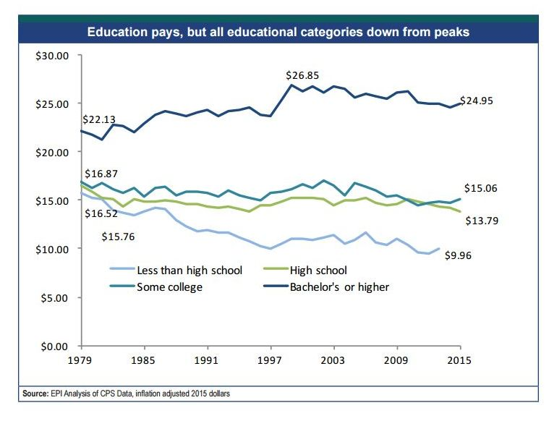
Legend inside the data rectangle adds clutter, detracts from comparisons, and can confuse readers.
Image source: Still Struggling: The State of Working Ohio 2016, Policy Matters Ohio.
*
Notes:
Better to use data labels adjacent to lines and omit legend. THE MAIN POINT IS PAY ATTENTION TO READABILITY. This designer did not.
Let’s see if this problem can be cleaned up.

Slide 63
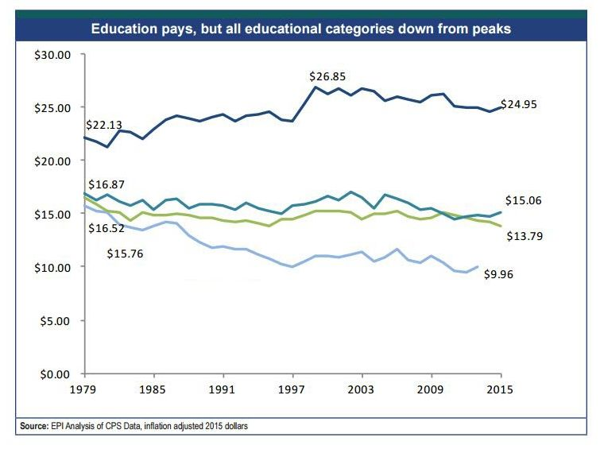
To illustrate, I removed legend from data rectangle. Note how more white space facilitates visual comparisons of data lines (and lets the data “tell their stories”).
Horizontal axis should extend to right of data labels (i.e., data rectangle). Axis span should be 5 year increments beginning with 1975.
Modified from: Still Struggling: The State of Working Ohio 2016, Policy Matters Ohio.
Notes:
READ

Slide 64
Oops. I failed to make the legend order match the data order.

Slide 65
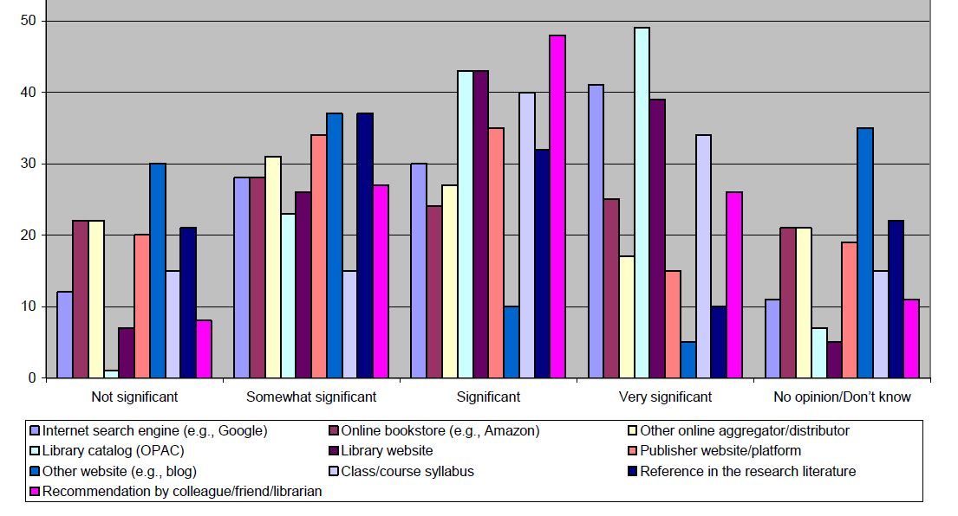
Here left-to-right order of legend symbol/data label pairs matches order of the bars (within each Likert category).
Use 4 or less categories (variables) in a bar chart. Create multiple charts as needed.
Image source: Highwire Press, 2009 Librarian eBook Survey, Stanford University, 2010.
*
Notes:
This bar chart’s main problem is readability / decipherability. 10 categories by 5 measures on 1 chart!!
Still, they were thoughtful enough to list categories in the legend to match the data.

Slide 66
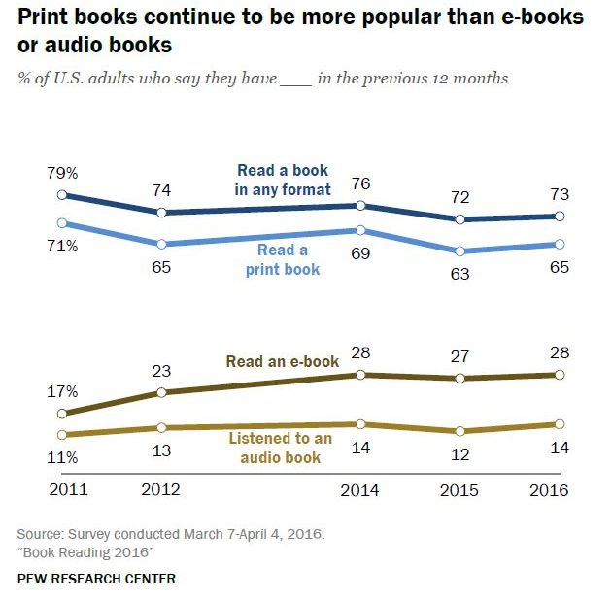
New trends:
Less formality, summarizing main conclusion(s) in title.
Titles are becoming more narrational, user-friendly.
Don’t compromise clarity, readability, accuracy, or truthfulness to make a point or engage readers.
Image source: Book Reading 2016, Pew Research Center, September 2016.
*
Notes:
Nowadays there is a trend, a positive one I think, to make charts a bit less stuffy and more informal—at least in final publications. So now chart titles contain conclusions analysts want audiences to hear about.
At the same time, if published charts are also meant to permit review of claims and other exploration of data, they still need the basics—like what the measures are, what the units are, what the data source is, has income adjusted for inflation, does the chart use a logarithmic scale, etc. etc.

Slide 67
Conclusions in chart titles should be clear, accurate, complete, and relevant.
Title in this chart misses the key point, wages among non-college educated, especially the 40% decline for HS dropouts.
Image source: Still Struggling: The State of Working Ohio 2016, Policy Matters Ohio.
*
Notes:
This is the chart I showed earlier, but I show it due to the conclusions expressed in the chart title.
Here a more complete conclusion would be “Since 1979, wages for college-educated improved moderately; other workers declined with HS dropouts declining by 40%.”

Slide 68
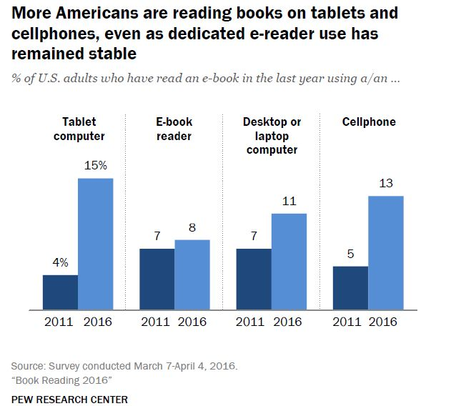
Use consistent data label values.
Data units (%) indicated in small font in chart sub-title. Chart has no vertical axis. Why, then, label data values ambiguously?
Image source: Book Reading 2016, Pew Research Center, September 2016.
*
Notes:
I include this chart maybe for a quick discussion. Perhaps for less clutter, more white space??, the designers show the units (percentage) in the left category only.
Maybe standards for graphs are becoming more lax—and readers will begin to learn that this is a sort of short-hand. However, right now this labeling is ambiguous.

Slide 69
Other Data Graphics Design Topics
(which we don’t have time to cover in this session)
Line charts | Dual-axes graphs
Bar charts | Re-expressing (transforming) data
Scatter plots | Histograms, box-and-whisker plots
Use of Color | Geographic maps
*
Notes:
So, what I’ve presented is the selection / sample of graphing guidelines I thought might be a good introduction. There is a lot more material in this area, some of which I list here.

Slide 70
Which Chart Formats To Use
Line Charts | To analyze trends, patterns, and exceptions over time
Bar or Column Charts | To compare categorical data To make specific comparisons in time (preferably two dates only)
Scatter Plots | To visualize how two variables vary together
Histograms / Box-and-whisker plots | To view and compare distributions
Notes:
READ

Slide 71
The Main Ideas
Spatial arrangement lets us visualize data in order to:
Make multiple immediate comparisons
Look for trends and patterns
Investigate individual values, including peculiar ones
Formulate key questions for further exploration
Notes:
READ
READ

Slide 72
The Main Ideas
The effectiveness of statistical graphs intended for exploratory purposes is enhanced when graphs are:
Accurate
Clear
Simple
Thorough
Impartial
Notes:
READ

Slide 73
ADDENDUM
The remaining slides present additional graphing guidelines & examples not included in the OPEG session due to time limitations.
Notes:
READ

Slide 74
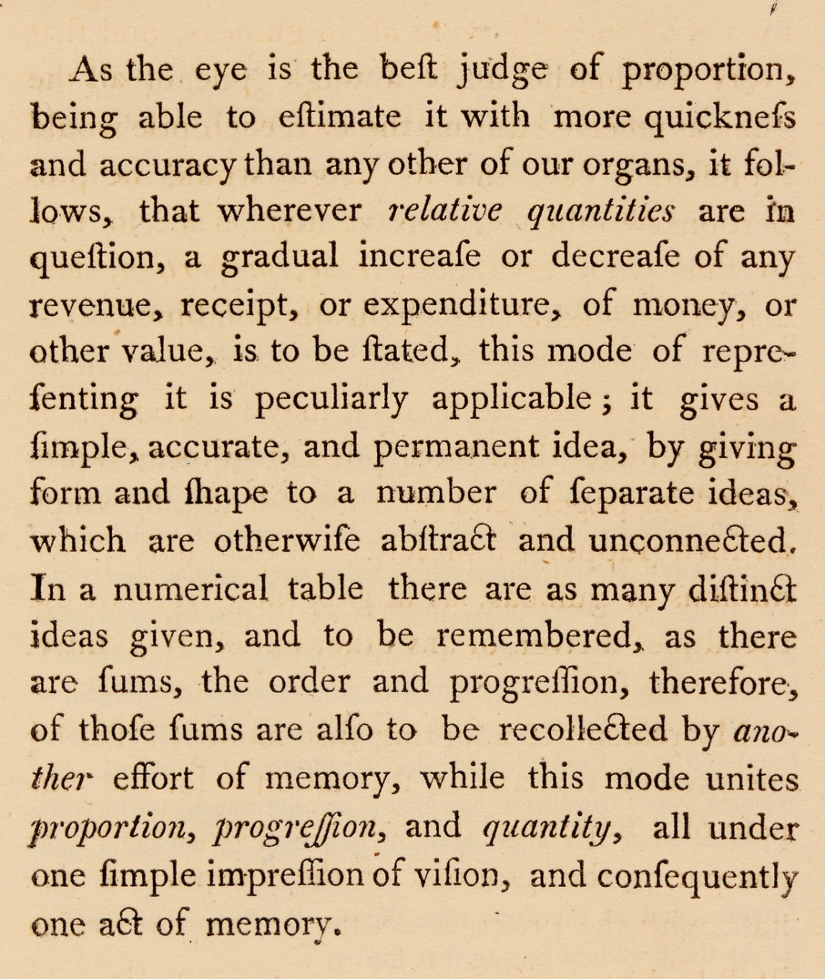
One simple impression of vision…
- William Playfair
William Playfair, The Commercial and Political Atlas, 1801, p. X.

Slide 75
Line Charts
Joseph Priestley invented the line chart in 1765
Perhaps the first use of a line chart to portray quantitative data was the one by William Playfair in 1786

Slide 76
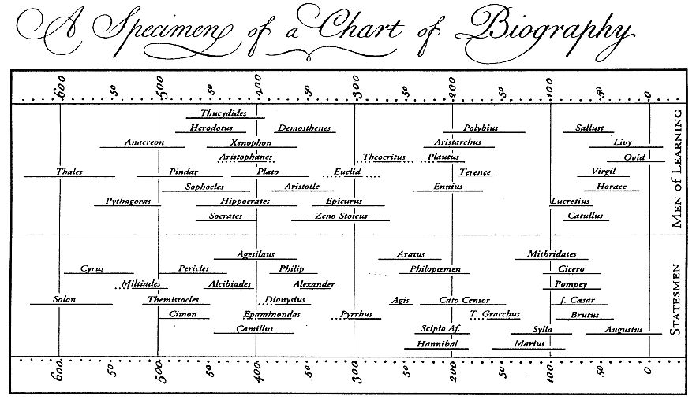
Source: Howard Wainer, 2005, Graphic Discovery
Joseph Priestley’s line chart (1765) depicted biographical history.

Slide 77
Line Charts
Use four or fewer lines. For more, use separate charts.
No spaghetti or spidery line charts.
Avoid all 3-D enhancements.

Slide 78
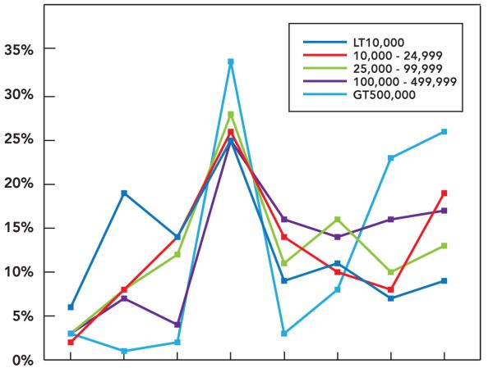
Too many lines in this chart. Separate charts needed.
Image excerpted from American Libraries, Nov. 2009.

Slide 79
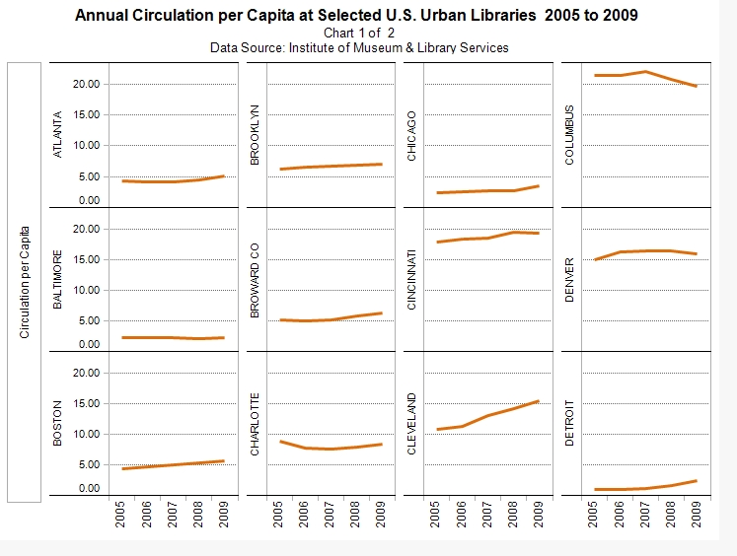
A trellis chart (aka lattice or small multiples) is a good format for displaying multiple data lines.

Slide 80
Line Charts
Lines should be thick enough to see without masking data peaks and valleys.
Use line charts to plot time-series data.
Usually (but not always) line charts are not appropriate for categorical data.

Slide 81
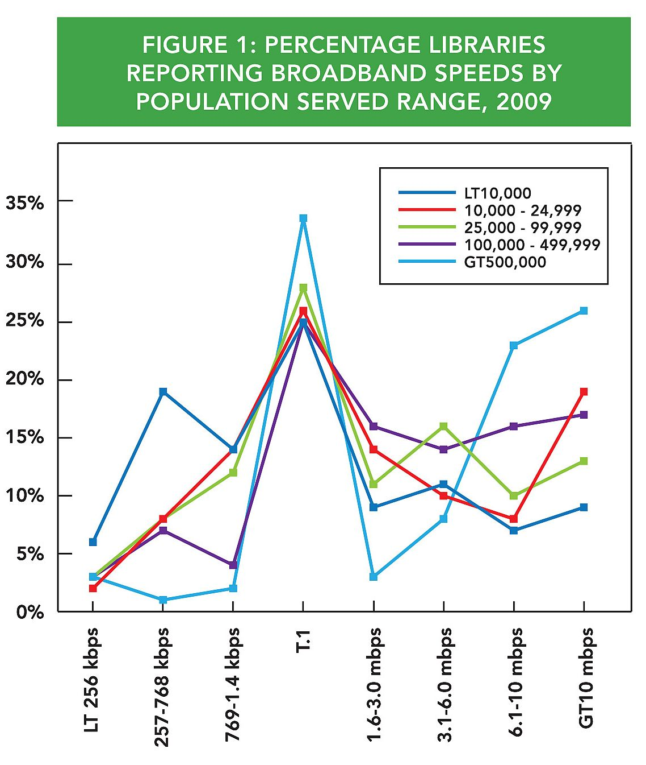
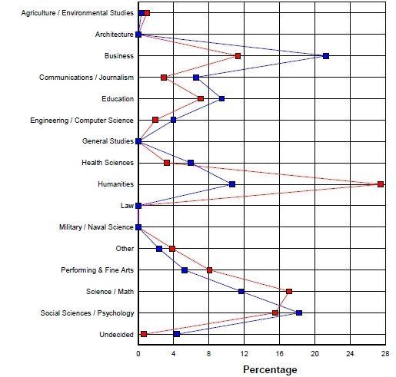
Use bar charts (not line charts) to depict categorical data.
With categorical data, lines between data points have no meaning. And they obstruct the data.
Left image source: American Libraries, Nov. 2009.
Right image excerpted from ARL Libqual® standard report notebook.

Slide 82
Line Charts
Do not shade below a line unless chart has a zero baseline.
When displaying data values, place these above lines when possible.
Try not to vary placement of data values; place the majority of data values above or all below the line.

Slide 83
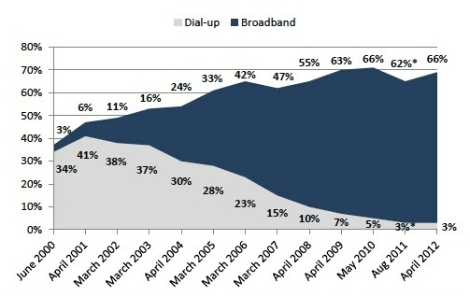
For line charts with shading below the line(s), the vertical scale should begin at zero, with zero clearly marked.
Image excerpted from PEW Research Center’s Internet & American Life Mobile Survey, 2012

Slide 84
A cumulative line plot can be confusing since data values for top series conflict with left axis. Explanations in caption or report narrative can clarify this for readers.
Image excerpted from PEW Research Center’s Internet & American Life Mobile Survey, 2012

Slide 85
Printing non-cumulative percentages gives another view of the data relationships.
Survey dates are centered between tick marks so that no data extends to either vertical axis.

Slide 86
Scaling for Line Charts
Dona Wong recommends choosing vertical axis scaling so that a rectangle surrounding line(s) covers about 2/3 of data area
William Cleveland recommends sizing scales so that data cover the majority of the data area.

Slide 87
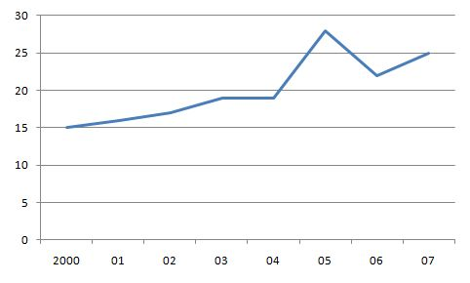
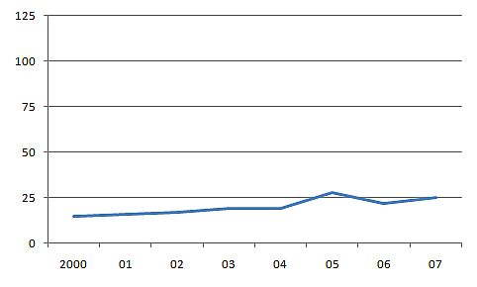
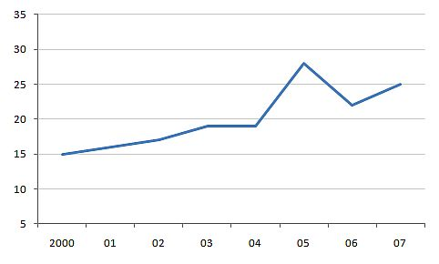
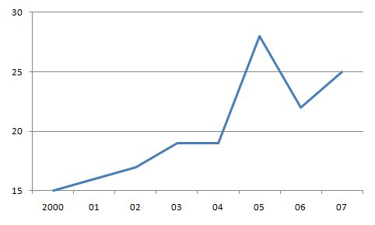
Bottom two charts utilize 2/3 or more of data area.

Slide 88
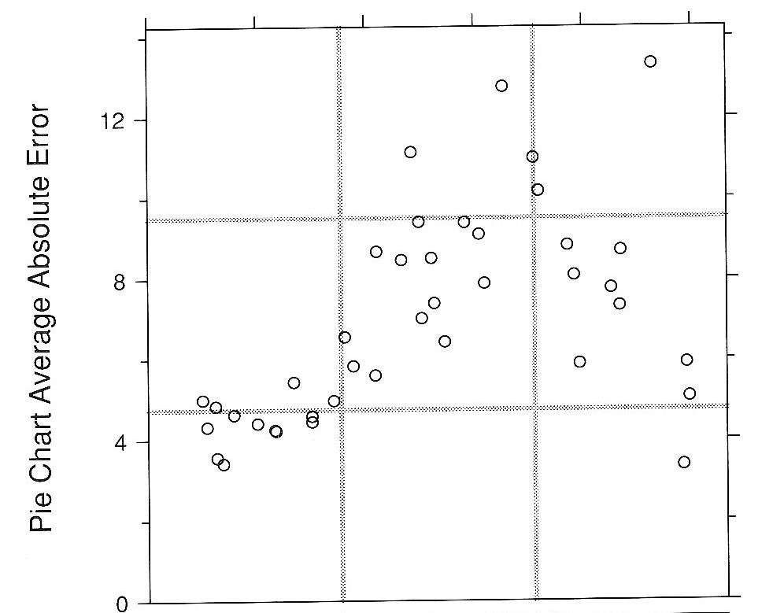
The importance of equivalent scaling for this comparison overrides the recommendation to fill 2/3 or more of the data area.
Images source: William Cleveland, 1994.

Slide 89
Using Color
97
Use color to distinguish or emphasize data.
Color variation should convey information.
Do not use color as decoration.

Slide 90
Multi-colored graphs are difficult to decipher.
Image source: American Libraries, Nov 2009

Slide 91
Warm and Cool Colors
Warm
Cool

Slide 92
Warm and Cool Colors
Warm colors: red, orange, yellow
Cool colors: blue, violet, neutral gray
Objects rendered in warm colors appear larger than cool colors.
Do not use colors from opposite sides of the color wheel together.

Slide 93
MS Excel 2007 default coloring for 2-bar chart combines inharmonious color. (They vibrate!)

Slide 94
High contrast (color or black & white) produces moire.

Slide 95
Use lower contrast, dimmer hues to avoid moire.

Slide 96
Using Color
Choose a single color palette (hues and shades of hues) for your entire set of graphs
Do not vary these for decorative purposes
Use shades of each hue*
* Depends on capability of graphing software used.

Slide 97
Color palette - bright
Source: Dona Wong, The Wall Street Journal Guide to Information Graphics, 2010.

Slide 98
Color palette - muted
Source: Dona Wong, 2010.

Slide 99
Using Color
Use a single color for each data variable, including pie charts.
Use a different shade, or occasionally a different color to highlight data.

Slide 100
Here multiple colors are used for the single variable perceived likelihood of Web 2.0 influence. Variation by age group indicated by bar heights.
Image source: South Carolina State Library, Social Media, Libraries, and Web 2.0, 2011.

Slide 101
MS Excel default chart color scheme: multiple color for single variable.

Slide 102
This chart uses one color for each variable. Hues are moderate and harmonious.
Image source: John B. Horrigan, Broadband Adoption and Use in America, 2010, US Federal Trade Commission

Slide 103
Using Color
In a single, related set of measures, use graduating shades of one color or colors on the same side of the color wheel in a multiple-bar chart.

Slide 104
Image source: U.S. Bureau of the Census 2004, We the People: Aging in the U.S.

Slide 105
Avoid thematic representation of colors, such as holiday colors.

Slide 106
Using Color
To emphasize one or more data bars, use distinctly lighter or darker shade than the color of the data series.
Or use a bright primary color; render others in a single, less prominent color.
With financial data, avoid use of red to indicate positive values.

Slide 107
Data can be emphasized by darker or brighter shades of a single hue.

Slide 108
When portraying data about a single variable* use alternate color for emphasis only
* Responses to one questionnaire item in this example.

Slide 109
Using Color
In black and white charts, emphasize important data series with dark black, and the others in grayer shades.
As a test, convert color charts to gray scale to evaluate shading.
If using a dark background for design reasons, render text in white only (not yellow, beige, etc.).

Slide 110
Bar Charts
139
Don't use shading or shadows.
Make width of bar about one to two times space between bars.
Make projections/estimates paler shade.

Slide 111
Wall Street Journal standard: gap = ½ bar width
Gap = bar width seems okay also

Slide 112
MS Excel programmers think bar charts are like sundials. They are not. Readers do not need to see where shadows might or might not fall.

Slide 113
Bar Charts
Don't mix colors or hash-patterns
Never use 3-D.
Use gray background to separate negative from positive zone of chart, if desired

Slide 114
Circus striping and hash patterns distract the reader’s eyes from the data.
Source : Cleveland State University, 2010, Self Study.

Slide 115
Which indicates the bar’s height? Front edge or back edge?
Never use 3-D.

Slide 116
Bar Charts
Plot bars from a zero baseline.
Non-zero baselines permissible for special purposes.
When bars are similar in height so as to be indistinguishable, consider plotting the differences between the values.

Slide 117
Bar Charts
When a bar is so small it is close to zero, add a data value label.
Do not use angled tick mark labels; redo as horizontal bar chart instead.
When using bars shaded in a single hue, go left to right from lightest to darkest.

Slide 118
Bar Charts
For multiple category charts, maximum number of categories is four.
Limiting to three categories is preferable.
Color-coding can make visually evaluating data more difficult, especially several colors/categories.

Slide 119
Leave eye-catching shapes and colors for Cirque de Soleil.
Go for simplicity and clarity.
Image source: Knight Commission on Intercollegiate Athletics, 2009, Restoring the Balance.

Slide 120
Bar Charts
If depicting exceptionally high values (‘outliers’), put break mark (zig-zag) in bar to show the gap in that bar.
Label the outlier value
Make that broken bar much taller than other bars to indicate the magnitude of the data value.

Slide 121
Horizontal Bar Charts
Typically used to rank items by a single characteristic, e.g. rankings; rank from largest to smallest or vice versa.
When listing in order by time interval, start with most recent interval first.
No shading or 3-D.

Slide 122
Horizontal Bar Charts
For a long list, label data points to the right, flush.
Order by important magnitude, not random or alphabetical order, unless chart is meant for lookup use.
With negative numbers, place zero on vertical axis at right and show negative numbers to the left.

Slide 123
http://libperformance.com
raylyons@gmail.com

